Slide 1
Functional Reactive Programming

Slide 2
What are
Functional and
Reactive Programming?

Slide 3
FRP
Functional
Programming
Reactive
Programming

Slide 4
Functional
Programming

Slide 5
Functional Programming
Programming paradigm based on this concepts:
Pure functions
Function composition
Avoiding shared state, mutable data, and side-effects
Referential Transparency and Immutability
Higher Order Functions
Currying

Slide 6
Pure Functions
FP
Given the same inputs, always returns the same output
Has zero side-effects
var data = [1, 2, 3, 4, 5, 6, 7]; var numbers = data.map(function (nr) { return nr + 1; }).filter(function (nr) { return nr % 2 === 0; });
// numbers = [2, 4, 6, 8]
Don’t mutate variables outside of their inner scope
Don’t mutate their arguments
Pure functions are definitionally simpler
Pure functions are simpler to test
Pure functions can be memoized
Can invoke other pure functions

Slide 7
Function composition
FP
Pure functions can be composed (chained) to get new functions
Composition is the main operation in Lambda Calculus
Allow us to build complicated data transformations from small pieces
Makes our code more reusable
//Compose function
const compose = (...args, funct) => args.reduce((a,b) => funct(a)(b));
//add function
const add = (a) => (b) => a + b;
console.log(compose([1,2,3], add)); //-> result is 6
console.log(compose(["a", "b", "c"], add)); //-> result is "abc"

Slide 8
Shared state
FP
Property of an object being passed between scopes
To understand the effects of a function, you have to know the entire history of every shared variable that the function uses or affects
Changing the order in which functions are called can cause a cascade of failures because functions which act on shared state are timing dependent
Remove function call timing dependency, and you eliminate an entire class of potential bugs
Avoid it!!

Slide 9
Side effects
FP
In Imperative Programming Languages, side effects are everywhere
Variables can be changed anywhere in your program => bugs!!
Avoiding side effects, the program is much easier to understand, and to test
Keeping side effects separate from the rest of your program logic, software will be much easier to extend, refactor, debug, test, and maintain, your code will be loosely coupled
Avoid it!!

Slide 10
Referential Transparency
FP
A pure function must be safely replaced by its expression without changing the program behavior
This can be especially helpful when reasoning about recursive functions
Helps providing the following benefits:
Correctness
Algorithm simplicity
Allows modify code without breaking it
Lazy evaluation
Memoization and common subsexpression elimination

Slide 11
Immutability
FP
A mutable object is any object which can be modified after it’s created
Immutability is a central concept of functional programming because without it, the data flow in your program is lossy, and strange bugs can creep into your software
There are a handful of strategies to accomplish this using JavaScript:
ES6 spread operator
Object.assign
Built-in pure functions such as map, filter, and reduce
Third-party libraries like Ramda, ImmutableJS, …

Slide 12
Higher Order Functions
FP
Function is a first-class citizen, a function is just another value, then can be passed as parameters
Higher-order Functions either take functions as parameters, return functions or both
Are also known as operators
const repeat = (times, funct, initial) => times > 0 ? repeat(times - 1, funct, funct(initial)) : funct(initial);
console.log(repeat(5, (_) => _ + `*`, ``)); //-> result is “*****”

Slide 13
Currying and Partial Function Application
FP
A curried function is a function that is invoked with fewer arguments than it was expecting:
When a curried function is partially applied returns a new curried function that expects the remaining arguments
When all arguments are supplied, the function is invoked
Are also known as operators
const add = (x: number) => (y: number) => x + y;
//We can do:
add(1)(3); // => 4
// and:
var add10To = add(10);
add10To(5); // => 15

Slide 14
Reactive
Programming

Slide 15
Reactive manifesto
Responsive: The system responds in a timely manner if at all possible
Resilient: The system stays responsive in the face of failure
Elastic: The system stays responsive under varying workload. Reactive Systems can react to changes in the input rate by increasing or decreasing the resources allocated to service these inputs
Message Driven: Reactive Systems rely on asynchronous message-passing to establish a boundary between components that ensures loose coupling and isolation

Slide 16
Limitations before Reactive Programming (1)
Frontend programs fire thousands of events, which need to be prepared to handle them effectively
This creates two important challenges: scalability and latency
With events we can get the known 6 plagues of listeners:
Unpredictable order
Missed first event
Messy state
Threading issues
Leaking callbacks
Accidental recursion

Slide 17
Limitations before Reactive Programming (2)
Main problem in frontend development: Blocking code
Non-blocking code with callback functions
Callbacks cannot solve the temporal dependency
Callback Hell
Alternatives?
Event emitters
Promises

Slide 18
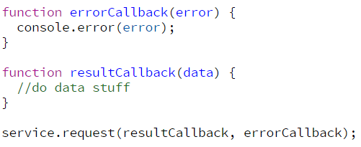
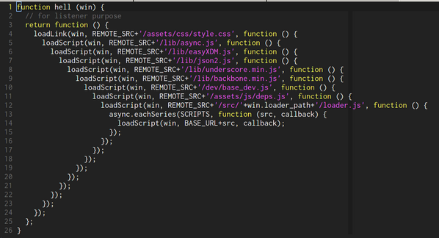
Callback Hell
RP
So far, so good!!
Callback Hell

Slide 19
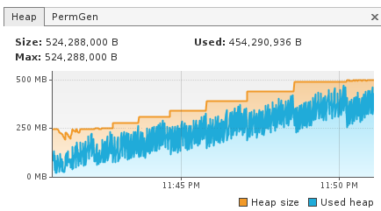
Event Emitters
FP
element.addEventListener(‘keyup’, keyupHandler);
function keyupHandler(e: KeyboardEvent) {
//do some stuff
}
Memory leaks

Slide 20
Promises
FP
Cannot handle more than one result
Cannot retry from failure
Cannot be cancelled

Slide 21
Reactive Programming
Resolve all problems described above and more:
Focuses on propagating changes without having to explecity how the propagation happens
Event-based
Acts in response to input
All is viewed as a flow of data, instead of the traditional flow control
Everything is a stream
Abstracts out the notion of latency away
Allow us to model our solutions using a linear sequence of steps
Powerful composition and aggregation of streams
Good fit for concurrent and event-driven systems
Easy to test

Slide 22
Push vs Pull
RP
Data
Pull
Transform
data
update

Slide 23
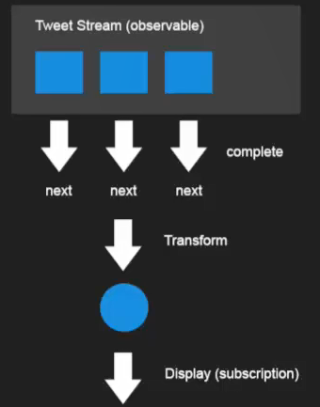
Push vs Pull
RP
Push

Slide 24
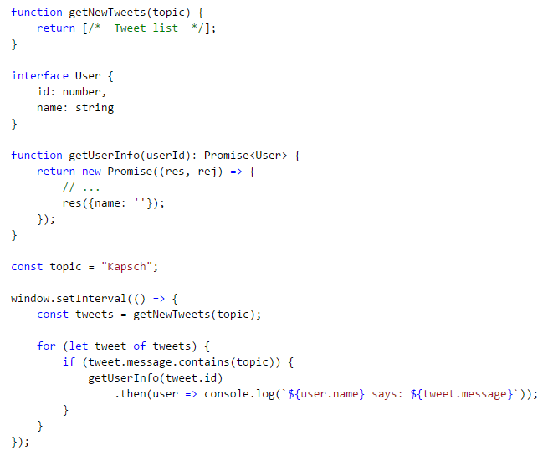
Push vs Pull
RP
Get tweets (pull)

Slide 25
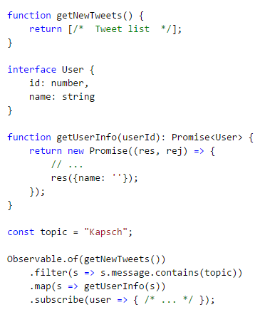
Push vs Pull
RP
Get tweets (push)

Slide 26
Functional
Reactive
Programming

Slide 27
What is FRP?

Slide 28
FRP
is a specific programming technique to improve your code in an area that just happens to be a common source of complexity (and therefore bugs): event propagation
Powerful composition and aggregation of streams
makes your code cleaner, clearer, more robust, and more maintainable, in a word, simpler
is a very different way of doing things. It will improve your code and transform your thinking for the better
Good fit for concurrent and event-driven systems
Easy to test

Slide 29
FRP
FP
Paradigm based on functions, in the mathematical sense of the word.
Avoids shared mutable state, so it implies the use of immutable data structures, and it emphasizes compositionality.
Functional
Programming
FRP
Reactive
Programming
RP
Event-based
Flow data
Gives looser coupling and code becomes more modular
FRP
A specific method of reactive programming that enforces the rules of functional programming, particularly the property of compositionality.

Slide 30
The main benefit of FRP:
Deals with complexity,
enforcing compositionality
reaches no side effects

Slide 31
FRP Requires
a
paradigm shift

Slide 32

Our FRP library: RxJS
Is a library for composing asynchronous and event-based programs using observable collections
Has a declarative syntax and composability while introducing an easy time handling and error model
Elevates data flow to be a first class architectural pattern on the level of MVC

Slide 33
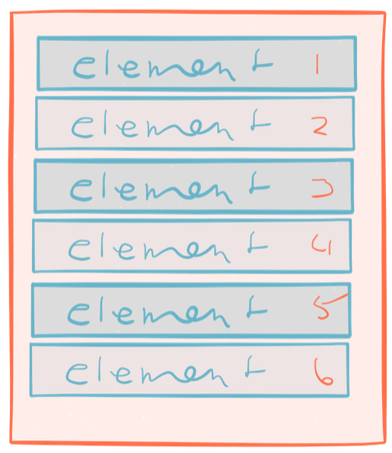
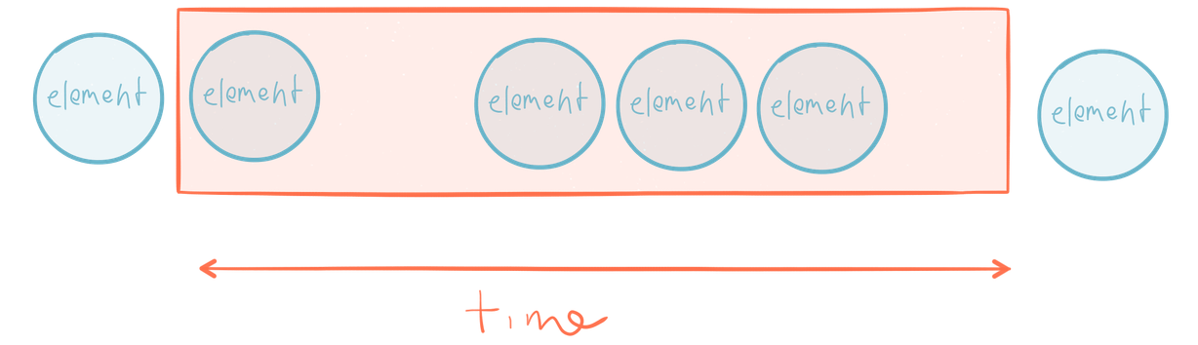
FRP Main concept: Stream
Streams are a series of elements emitted over time
No!
But, isn’t this an Array?
Arrays have beginning and an end
A Stream has no beginning and no end

Slide 34
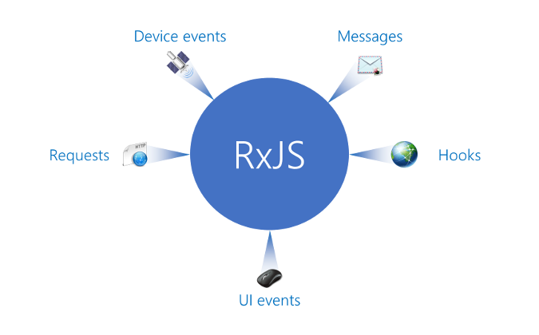
RxJS: All is a stream!!!

Slide 35
FRP Core concepts
- The Observable object represents a push based collection.
- The Observer and Observable interfaces provide a generalized mechanism for push-based notification (Observer design pattern):
Observable: represents the object that sends notifications (the provider)
Observer: represents the class that receives them (the observer)
Observables
Operators
Each operator in the chain modifies the Observable that results from the operation of the previous operator
Subscriptions
Represents a disposable resource, such as the execution of an Observable

Slide 36
Observables

Slide 37
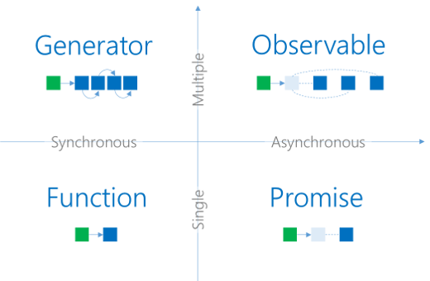
Observable
RxJS
Represents a sequence of values over time
Is asynchronous
Is Lazy
To get values out, you have to subscribe to it

Slide 38

Observable
RxJS
Don’t you understand what Observable and Observer are?
Observer
const observer = (data, nextCB, errorCB, completeCB) => { next = (e) => nextCB(e); error = (err) => errorCB(err); complete = () =>completeCB(); }
Observable
const observable = (observer) => { const datasource = new DataSource(); datasource.ondata = (e) => observer.next(e); datasource.onerror = (err) => observer.error(err); datasource.oncomplete = () => observer.complete();
return () => { datasource.destroy(); }; }

Slide 39
Observable
RxJS
Types
Cold observable
Hot Observable
Starts running upon subscription: only pushes values to the observers when subscribe method is called
Emits immediately whether its Observer is ready or not and regardless of subscribers
Every observer can see whole stream
Is shared among all subscribers, and each subscriber is pushed the next value in the sequence
Examples:
Service Request
Reading file
Examples:
Mouse events
Video streaming

Slide 40
Operators

Slide 41
Operators
RxJS
Allow us to spawn sequences of asynchronous requests taking advantage of pure functions to keep all of the information properly scoped
Allow us to manipulate or edit the data passing it from the producer to the consumer (pipeline):
we can adapt the output of the producer to match the expectations of the consumer
promotes a separation of concerns
This design principle is typically extremely hard to accomplish in large-scale JavaScript applications, but RxJS facilitates this model of design

Slide 42
Operators
RxJS
Categories
Combination
Creation
Transformation
Filtering
Error handling
Multicasting
…
Observable.fromEvent(input, ‘keyup’)
.map(event => event.target.value)
.filter(text => text.length > 3)
.distinctUntilChanged()
.switchMap(term => service.getResult(term))
.subscribe(console.log);

Slide 43
Operators that you may know

Slide 44
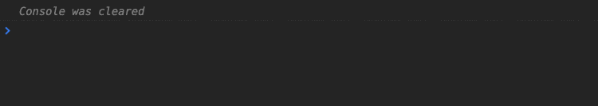
Concat
RxJS
Subscribe to Observables in order but only when the previous completes, then move to the next one

Slide 45

forkJoin
RxJS
Don’t let me know until all the Observables are complete, then give me all the values at once

Slide 46
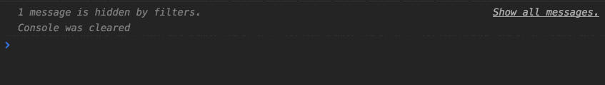
mergeMap
RxJS
Only when the inner Observable emits, let me know by merging the value to the outer Observable

Slide 47

switchMap
RxJS
Like mergeMap but when the source Observable emits cancel any previous subscriptions of the inner Observable

Slide 48
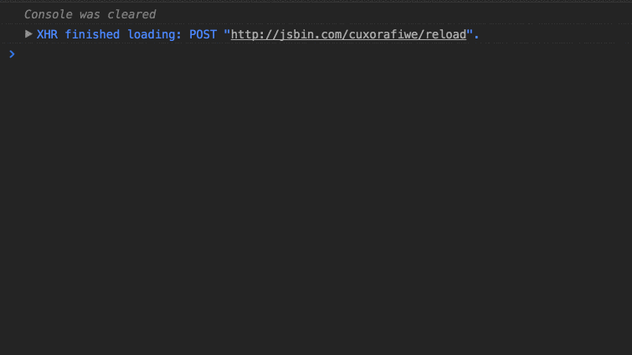
combineLatest
RxJS
Let me know when any Observable emits but also give me the latest value from the others

Slide 49
Subscriptions

Slide 50
Subscriptions
RxJS
calling subscribe() on an observable source returns a Subscription object
A subscription is the consumer of an observable, with IoC gets the desired data
This is a consistent push-based mechanism

Slide 51
Global idea

Slide 52
Mind map
next( )
Observable
Observer
.subscribe()

Slide 53
With Observable we cannot do neither
.next(), .complete() nor .error() !!??

Slide 54
Subjects to the rescue!!

Slide 55
Subjects
RxJS
Subject-Observer design pattern:
Inherit from Observer and Observable
Have next, complete and error methods
Can act as a proxy for a group of subscribers and a source
Are not reusable: when a Subject completes or errors, it can no longer be used, it will silently
ignore the future notification.
Diferent types: AsyncSubject, ReplaySubject, BehaviorSubject, …

Slide 56
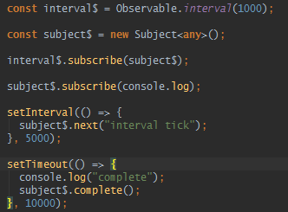
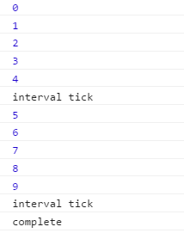
Subjects
RxJS
Subject as an observer
Able to stop receiving values

